Slide 1

Welcome to our
MATHEMATICS
Class
Prepared by: Mr. Fajardo

Slide 2

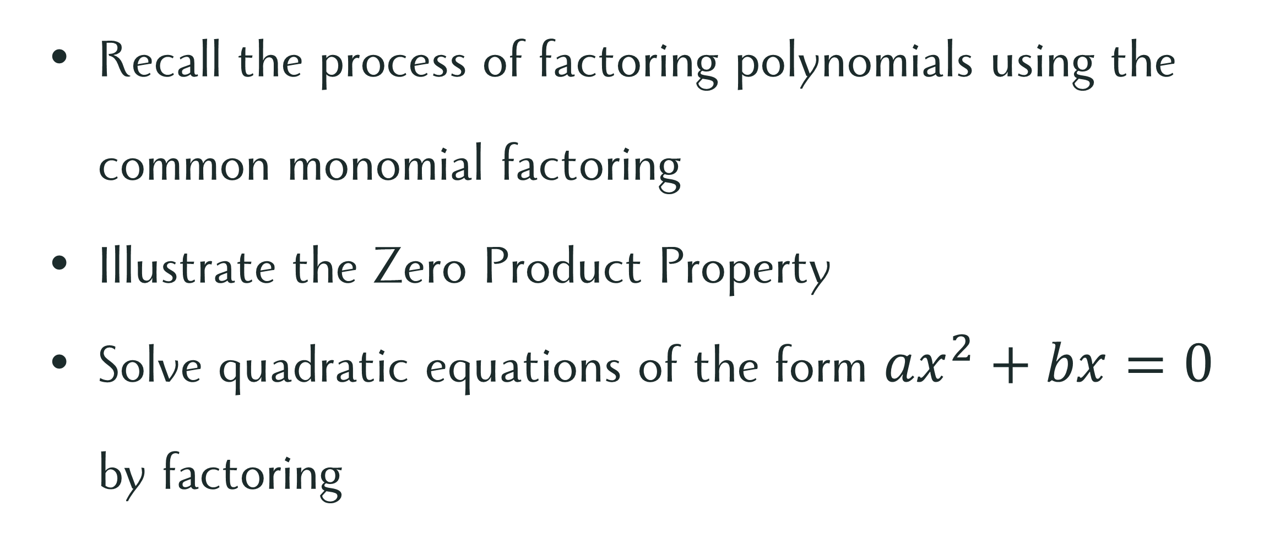
Learning Objectives
Recall the process of factoring polynomials using the common monomial factoring
Illustrate the Zero Product Property
Solve quadratic equations of the form $ax^{2}+bx=0$ by factoring

Slide 3
Let’s recall!

Slide 4
Let’s recall!
Factor the following polynomials completely.

Slide 5
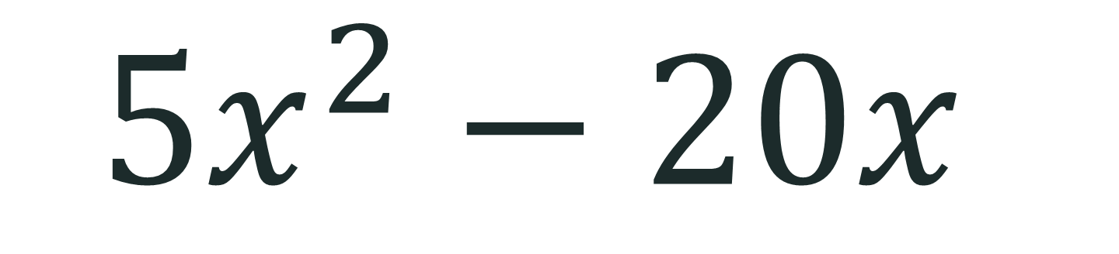
Factor the following polynomials completely.
$$5x^{2}−20x$$

Slide 6
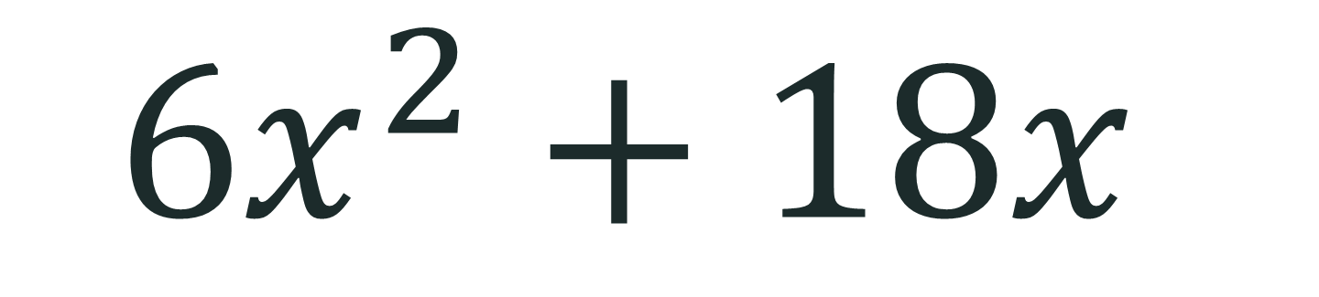
Factor the following polynomials completely.
$$6x^{2}+18x$$

Slide 7
Processing Question:
What if these polynomials were written as equations? Could factoring help us solve for the value/s of the variable?

Slide 8
Quadratic equations
Solving
$$(ax^{2}+bx=0)$$
by Factoring

Slide 9
Zero product property

Slide 10
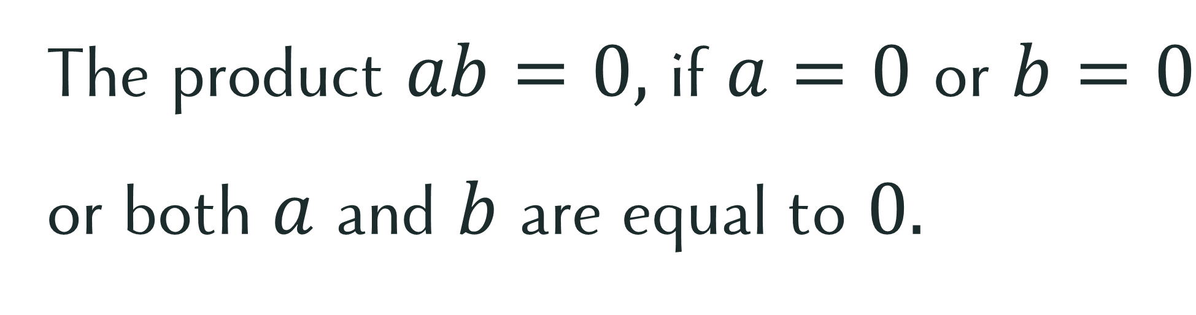
Zero Product Property
The product $ab=0,$ if $a=0$ or $b=0$ or both $a$ and $b$ are equal to $0.$

Slide 11

Solve the quadratic equations.
$4x^{2}+12x=0$
$5x^{2}−20x=0$
$6x^{2}+18x=0$

Slide 12
Let’s practice!

Slide 13

Let’s Practice!
Solve the quadratic equations.
$2x^{2}+10x=0$
$3x^{2}−15x=0$
$8x^{2}+24x=0$

Slide 14
Comprehension check

Slide 15

Comprehension Check
Solve the quadratic equations. Show your complete solution.
$9x^{2}−27x=0$
$4x^{2}+16x=0$
$12x^{2}−36x=0$
$15x^{2}+30x=0$
$3x^{2}−15x=0$

Slide 16

Error Analysis
A student solved the equation $4x^{2}+20x=0$as follows:
$$4x\left(x+5\right)=0$$
$$4x=0$$
$$x=0$$
The student concluded that $x=0$ is the only solution.

Slide 17

Error Analysis
A student solved the equation $4x^{2}+20x=0$as follows:
$$4x\left(x+5\right)=0$$
$$4x=0$$
$$x=0$$
The student concluded that $x=0$ is the only solution.
Is the student’s solution complete?

Slide 18
Compassion
When a classmate struggles to factor an equation or understand the Zero Product Property, how can you show compassion by guiding them toward the solution instead of simply giving them the answer?

